Slide 1
Team Red Ocean’s
Central Jersey
Food Rescue
Nonprofit Organization
April 26, 2023
Anjali Dembla, Namrata Rath, Ronil Patel, Saranya Mantena, Vicki Wang
Notes:
Ron

Slide 2
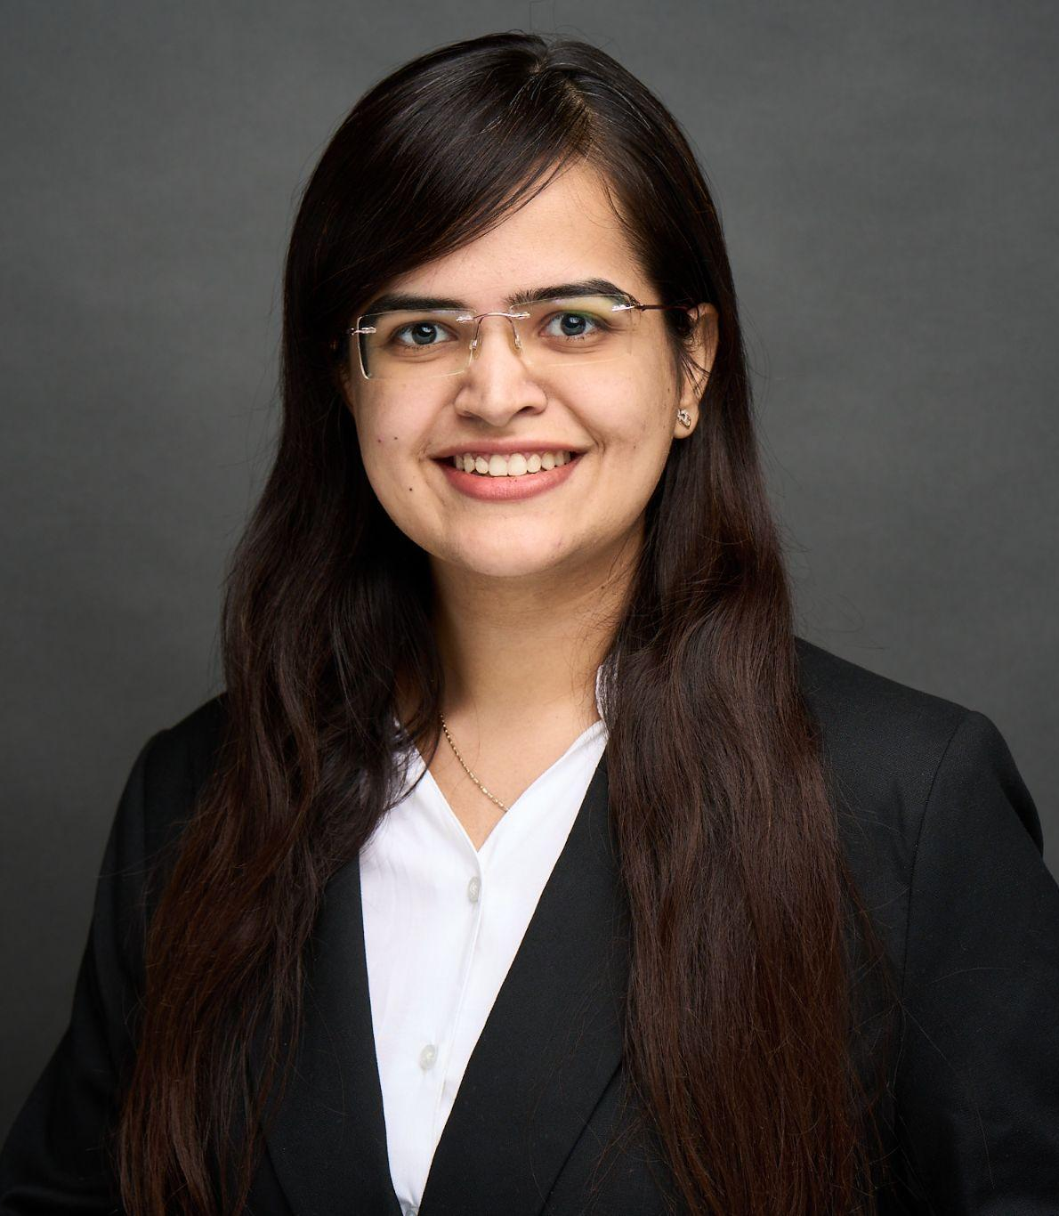
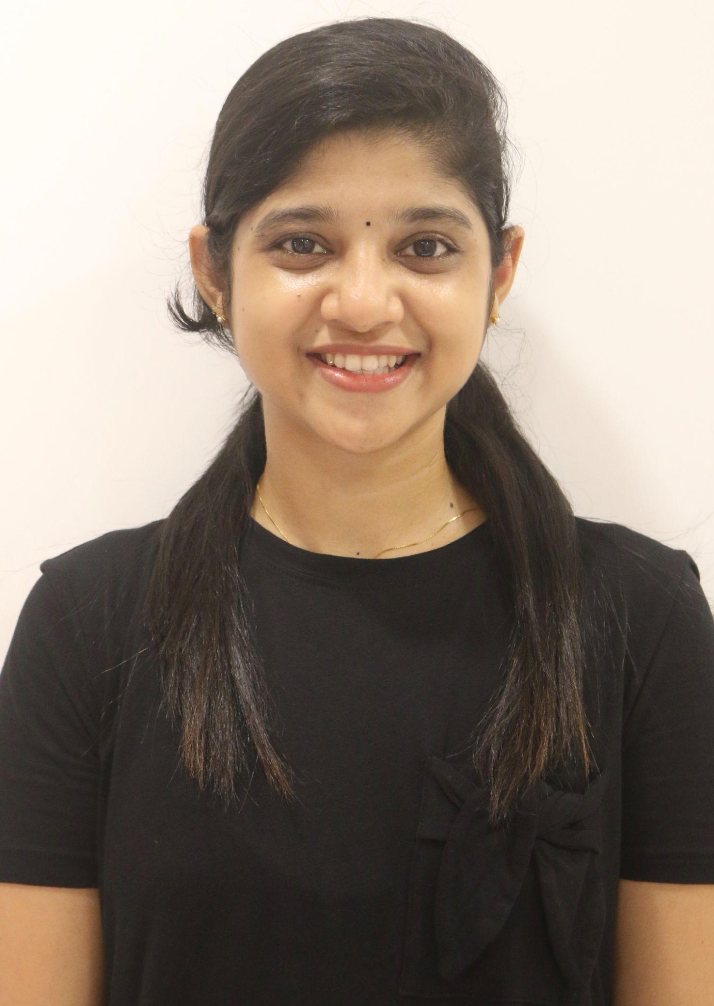

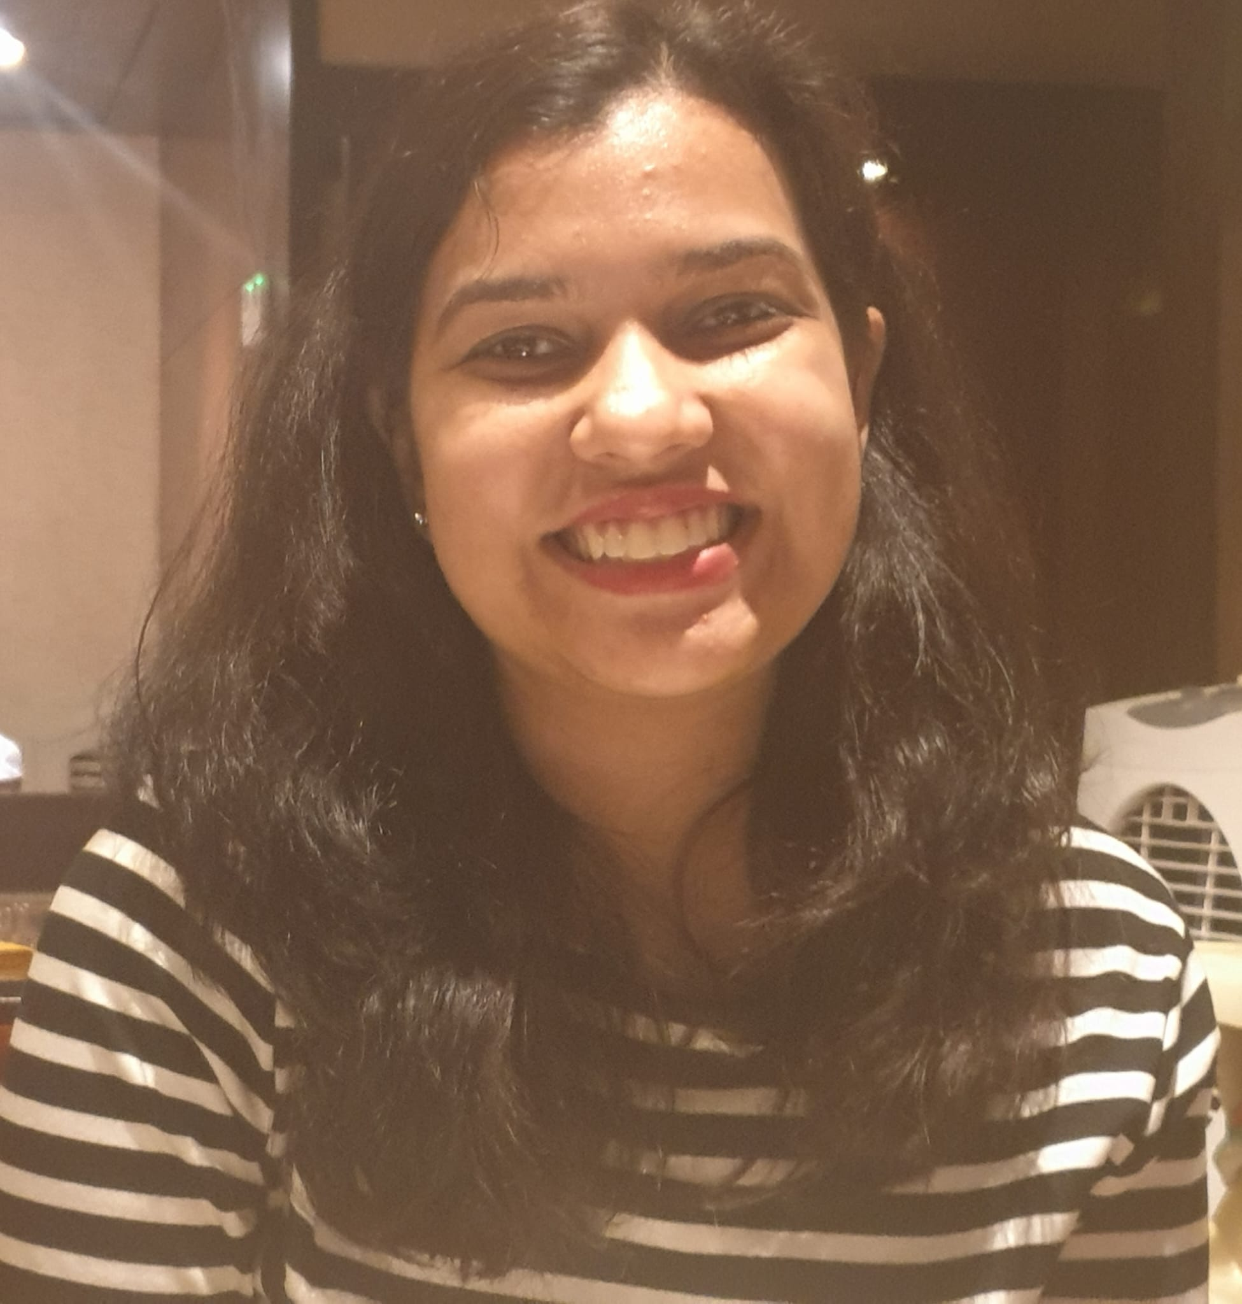
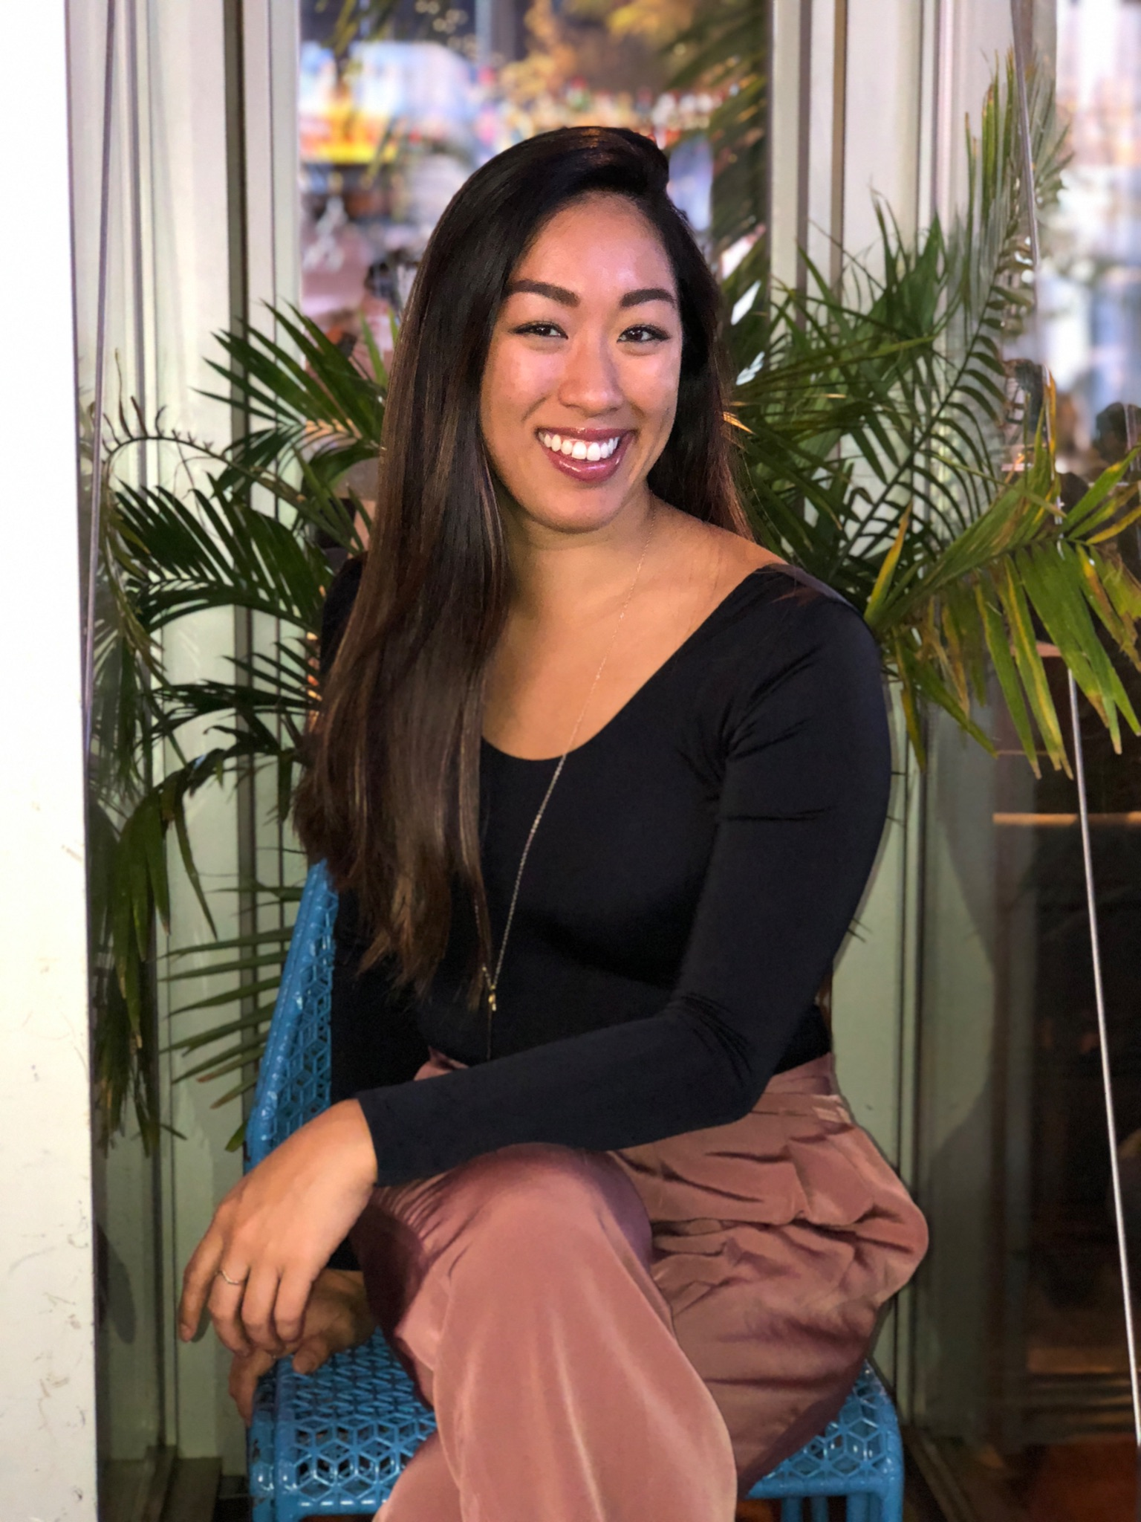
Team Red Ocean
Anjali Dembla
Saranya Mantena
Ron Patel
Namrata Rath
Vicki Wang
Notes:
Ron

Slide 3
Project Plan Overview
Initiating
Planning
Executing
Monitoring & Controlling
Closing
Five Process Groups
Charter
Business Case
Stakeholder Analysis
Requirements List & Matrix
Scope Statement
Work Breakdown Structure (WBS)
Schedule
Cost Estimate
Communications Plan
Risk Probability / Impact Matrix
Issue Log
Change Requests
Lessons Learned
Notes:
Ron

Slide 4
Initiating
Notes:
Ron

Slide 5
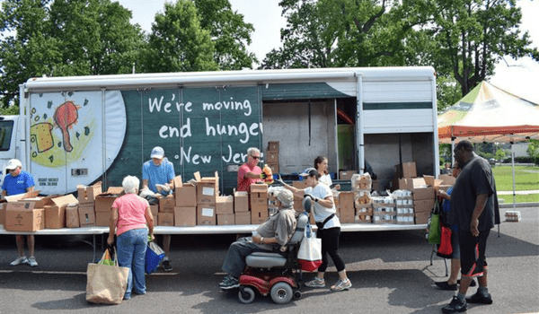
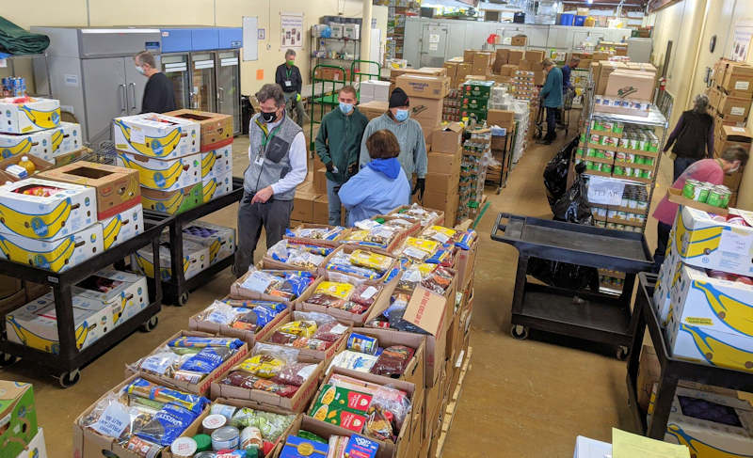
Business Case
Initiating
Planning
Executing
Monitoring & Controlling
Closing
Nonprofit food bank:
an organization that collects, sorts, and distributes food to individuals and families in need
Problem:
42M people food-insecure
13M children
30-40% food is wasted
Team Red Ocean Nonprofit can:
Provide a PUBLIC GOOD
IMPROVE WELL-BEING of individuals and families
HUB for members to CONNECT, VOLUNTEER, COLLABORATE
Notes:
Ron

Slide 6



Project Charter
Initiating
Planning
Executing
Monitoring & Controlling
Closing
Project: Central Jersey Food Rescue Nonprofit
Objective: Develop a project plan and presentation for a nonprofit organization that rescues food waste from local organizations and transports it to serve food-insecure populations in Central New Jersey by April 26, 2023.
Budget: $3,030
Project Manager: Vicki Wang
Deliverables: 12 project management documents; presentation; in-person team presentation
Success Criteria: Deliverables completed on time and within +/- 10% of budget. Stakeholder requirements met.
Risks: Adherence to schedule, overall plan quality, scope creep, communication misunderstandings.
Sponsor Sign-off
Notes:
Anjali
Slide 1: Project Charter
A project charter is a formal document that outlines the objectives, scope, and participants of a project. It is typically created at the beginning of a project and serves as a roadmap for the project team to follow throughout the project's lifecycle
Project Objective
The objective of this project is to develop a project plan and presentation for a nonprofit organization that rescues food waste from local organizations and transports it to serve food-insecure populations in Central New Jersey.
Mention the deadline for the project completion.
3: Budget
The budget allocated for this project is $3030.
Explain how the budget will be used and allocated throughout the project.
4: Project Manager
Vicki Wang is the Project Manager for Central Jersey Food Rescue Nonprofit
Briefly discuss the responsibilities of the project manager.(Oversee project, create project schedule, manage project team, create meeting agendas, manage deliverables and timelines, manage risk log, plan contingencies for unforeseen risks, track project budget, communicate with Client, schedule and conduct meetings, oversee project (assign tasks, weekly reports to Client, etc), facilitate communication and task completion)
Slide 5: Deliverables
There are 12 project management documents that need to be completed as part of this project.
Mention the types of documents that need to be completed.
The final deliverables will include a presentation and an in-person team presentation.
Slide 6: Success Criteria
The success criteria for this project include delivering all the project management documents on time and within +/- 10% of the budget.
Mention that the stakeholder requirements must be met.
Slide 7: Risks
There are a few risks associated with this project, including adherence to schedule, overall plan quality, scope creep, and communication misunderstandings.
Explain each risk in detail and how the project team plans to mitigate them.
Slide 8: Sponsor's Signature
The sponsor's signature is required for the project to begin.
Explain the importance of the sponsor's signature
Project Charter: Document that formally recognizes the existence of a project and provides a summary of the project’s objectives and management. After meeting to brainstorm nonprofit ideas, the team will collaborate on Google Docs using the template provided in class. The team will follow up with the professor during class to clarify the breadth of this document and then return to the document to fine tune. All team members will be involved. This document will also require the cost estimate determined in Document 7.

Slide 7
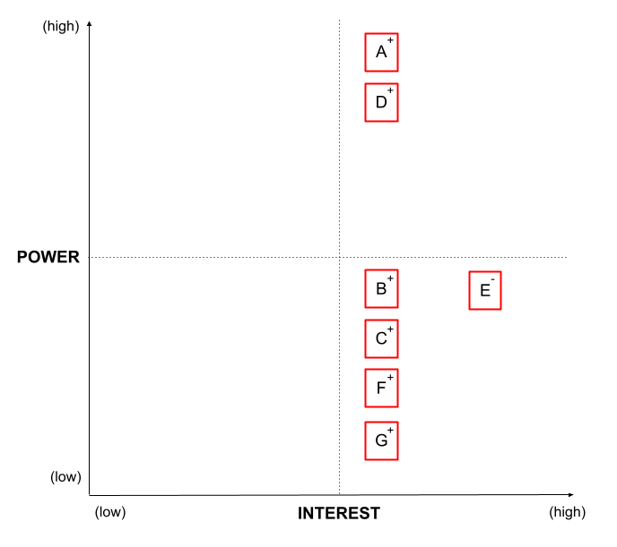
Stakeholder Analysis
Initiating
Planning
Executing
Monitoring & Controlling
Closing
High Power + High Interest
Client/Professor (+)
Project Manager (+)
Project Team Members (+)
Investor Panel (2 members) (+)
Competing Food Rescue Nonprofits (-)
Sponsor (+)
Food insecure citizens (+)
Notes:
Anjali
A stakeholder matrix is a tool used to analyze and categorize stakeholders based on their level of interest in the project and their level of influence on the project's success. This matrix helps project teams to identify the key stakeholders, understand their needs and expectations, and develop appropriate communication and engagement strategies.
The stakeholder matrix typically consists of four quadrants, as follows:
High Power, High Interest: These stakeholders are the most important to the project's success, and they have a high level of influence on the project's outcome. Project teams must prioritize their needs and expectations and engage them closely throughout the project.
High Power, Low Interest: These stakeholders have a high level of influence on the project but a low level of interest. Project teams should keep them informed about the project's progress but do not need to engage them closely.
Low Power, High Interest: These stakeholders have a high level of interest in the project but a low level of influence. Project teams should keep them informed about the project's progress and involve them as appropriate.
Low Power, Low Interest: These stakeholders have a low level of interest in the project and a low level of influence. Project teams should keep them informed but do not need to engage them closely.
Stakeholder List: Document that includes details related to the identified project stakeholders, including classification. After meeting to brainstorm upon relevant stakeholders, we will collaborate on Google Docs using the process from class. The team will follow up with the professor during class to clarify the breadth of stakeholders and then return to the document to fine tune. After a final list of stakeholders is determined, stakeholders will be (1) classified according to their power and interest, and (2) identified as positive (+), negative (-), or neutral (no sign). All team members will be involved.
Stakeholder Matrix: Power/interest grid based on stakeholder level of authority and concern. After compiling and classifying the list of relevant stakeholders, a grid will be created in Google Docs based on the template provided in class. Stakeholders will then be mapped on this grid using codes from the Stakeholder List. One team member will work on this deliverable.

Slide 8
Planning

Slide 9
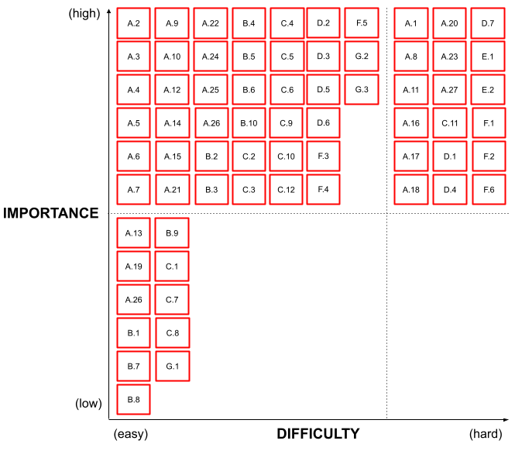
Requirements Matrix
Initiating
Planning
Executing
Monitoring & Controlling
Closing
A.1. [Client]
Deliver presentation and respond to any subsequent questions within a 40-minute timeframe on April 26th from 6-9PM EST
C.11. [Team Members]
Adhere to project timelines or seek alternative actions as soon as possible (e.g. within the week).
E.1. [Competing Food Rescue Nonprofits]
New Red Ocean team nonprofit will create a unique business plan and operating model; they will not mimic any business plans or operating models of existing food rescue nonprofits in Central New Jersey. The new nonprofit will seek alternative sources of funding, solicit alternative retail organizations for food waste donations, seek volunteers not currently giving their time to existing food-related organizations, operate in regions without currently existing food rescue organizations, and seek to serve food insecure populations not currently being served.
High Difficulty + High Importance
Notes:
Anjali
Requirement matrix:-
Categorize the requirement in regards to of level of interest and level of difficulty.
Talking about the requirements that ahd high difficulty and High Importance level:_
Client
A.A.1 [Client]:
Delivering a presentation and responding to subsequent questions within a 40-minute timeframe requires a significant amount of preparation and skill. It requires the ability to clearly and concisely communicate complex ideas, answer questions on the spot, and engage with the audience. Additionally, the presentation should be informative, persuasive, and engaging to keep the audience interested. Therefore, it would be considered of high difficulty.
On the other hand, the presentation may be of high interest because it provides an opportunity for the client to showcase their expertise, vision, and achievements to a wider audience. It may also attract potential investors, partners, or supporters for the project, which could lead to more funding, resources, and impact.
C.11 [Team Members]:
Adhering to project timelines or seeking alternative actions as soon as possible requires a high level of organization, planning, and problem-solving skills. It requires the ability to set clear goals, prioritize tasks, track progress, and communicate effectively with other team members. In case of delays or unexpected obstacles, team members must be able to find creative and efficient solutions to keep the project on track. Therefore, it would be considered of high difficulty.
On the other hand, adhering to project timelines may be of high interest because it is essential for the success of the project. It ensures that the project is completed within the allocated resources and timeframe, which increases the chances of achieving the desired outcomes. It also helps to build trust and credibility with stakeholders, which could lead to more opportunities in the future.
E.1 [Competing Food Rescue Nonprofits]:
Creating a unique business plan and operating model requires a high level of innovation, creativity, and strategic thinking. It requires the ability to identify gaps in the market, develop a value proposition, design a business model, and assess the feasibility and sustainability of the plan. Additionally, the plan should be adaptable to changing market conditions, regulations, and customer preferences. Therefore, it would be considered of high difficulty.
On the other hand, creating a unique business plan and operating model may be of high interest because it provides a competitive advantage and differentiation from other food rescue nonprofits. It also enables the organization to better serve its mission and target audience, optimize its resources, and increase its impact. It may also attract new partners, donors, or supporters who are interested in innovative and effective solutions to food waste and hunger.

Slide 10
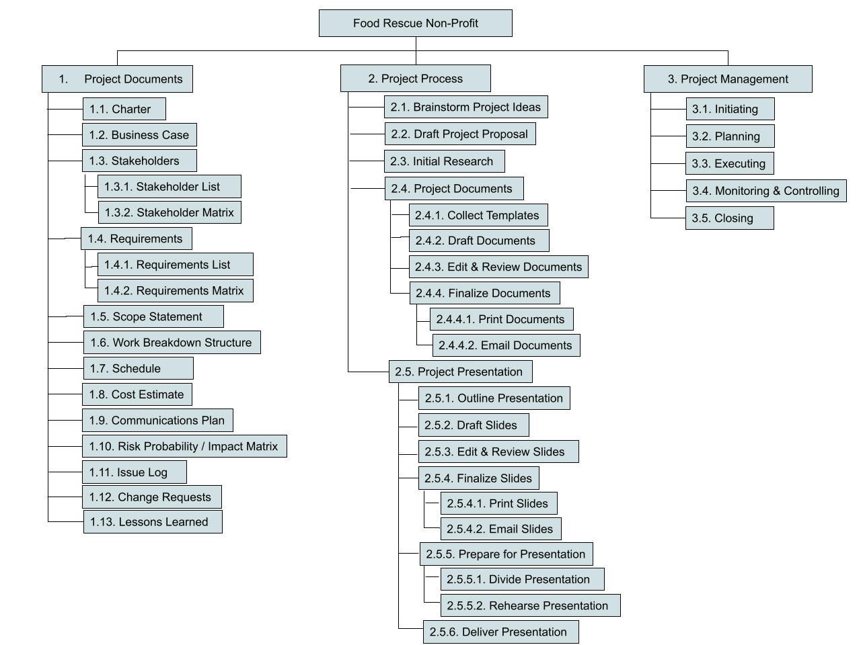
Work Breakdown Structure
(WBS)
Initiating
Planning
Executing
Monitoring & Controlling
Closing
100% of the work
Out of the WBS → out of scope
Technique: decomposition
Notes:
Vicki
Work Breakdown Structure (WBS): Deliverable-oriented grouping of the work involved in a project that defines the total (100%) scope/work of the project. This graphical representation breaks all the work required for the project into discrete deliverables, and groups them into a logical hierarchy. The team will meet on Zoom to brainstorm and then will use the technique of decomposition to create this deliverable, which involves starting with the highest level of the project scope and progressively breaking it down into smaller and more detailed work packages. Based on examples and best practices learned from class, one team member will create the final WBS deliverable in Google Docs. All team members and the professor will be engaged to critique the contents of the WBS. Updates will be made as necessary depending on feedback and the project itself.
Work packages are deliverables at the lowest WBS level where it can be appropriately assigned to and managed by a single accountable person. Work packages should have enough detail to estimate cost and time/resources to complete it. The best practices covered in class include: (1) out of the WBS means out of scope, and (2) the 100% Rule: 100% of the work that creates L1 must be contained in the levels below.

Slide 11
WBS Part I:
Project Documents
Initiating
Planning
Executing
Monitoring & Controlling
Closing
[Change request]
Notes:
Vicki

Slide 12
WBS Part II:
Project Process
Initiating
Planning
Executing
Monitoring & Controlling
Closing
Notes:
Vicki

Slide 13
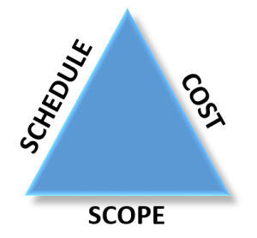
WBS Part III:
Project Management
Initiating
Planning
Executing
Monitoring & Controlling
Closing
Notes:
Vicki
Initiating: Define the project and its objective, timeline, and resources; clarify project goals and expectations.
Planning: Determine the steps that will lead the team to achieve project scope, schedule, and cost goals
Executing: Put plan into action – develop and manage the project team and other stakeholders to carry out project plans and produce project deliverables.
Monitoring/Controlling: Collect, measure, and disseminate progress toward achieving project goals
Closing: Formalize acceptance of the project and bring it to an orderly end; plan for smooth transition of results of project to investor panel (including client).

Slide 14
Scope Statement:
Key Product Scope Deliverables
Initiating
Planning
Executing
Monitoring & Controlling
Closing
Example
1
A.11. The project plan should be convincing, comprehensive, and thorough so that the client can understand why the Red Ocean team is pursuing funding for creation of this nonprofit. The problem or opportunity should be clearly and concisely stated. The objective of the nonprofit should also be clearly and concisely stated.
Client
Requirement
Example
2
B.6. Adequate tools and training will be available to the Project Team throughout the course of the project. At a minimum, these tools consist of the following: high-speed internet connection, cloud-based storage infrastructure, computer software programs (e.g. Microsoft Office Suite, ProjectLibre or Microsoft Project), computer hardware (e.g. printers), and messaging platforms (e.g. WhatsApp). One training session will be needed for at least one of the computer software programs (e.g. ProjectLibre or Microsoft Project)
Project Manager Requirement
Example
3
C.10. The project team will create a central repository of information including project developments and progress, the schedule, key responsibilities each week, project requirements, etc. that can be accessed by all on an as-needed basis. Information will reside here for general knowledge and will be updated on a weekly basis by the Project Manager.
Project Team Member Requirement
Notes:
Vicki
Scope Statement: Document describing overall project objectives, product characteristics and requirements, user acceptance criteria, project deliverables, project boundaries (what is out of scope), constraints, and assumptions. We will collaborate on Google Docs using the template provided in class. Individual team members will draft paragraphs for each product requirement and project scope deliverable. Product requirements must be SMART. These drafts will be reviewed and revised iteratively to ensure they accurately reflect the project’s scope and align with the project’s objectives. All team members will be involved in this deliverable. This document will also require the cost estimate determined in Document 7.

Slide 15
Scope Statement:
Key Project Scope Deliverables
Initiating
Planning
Executing
Monitoring & Controlling
Closing
Example
1
Document describing overall project objectives, product characteristics and requirements, user acceptance criteria, and deliverables; also project boundaries (what is out of scope), constraints, and assumptions. We will collaborate on Google Docs using the template provided in class. Individual team members will draft paragraphs for each product requirement and project scope component. These drafts will be reviewed and revised iteratively to ensure they accurately reflect the project’s scope and align with the project’s objectives. All team members will be involved in this deliverable. This document will also require the cost estimate determined in Document 7.
1. Project Documents
1.5. Scope Statement
Example
2
Two team members will collect all required templates provided by the professor from the PowerPoint PDF lectures and/or textbook and input them into a collaborative Google Doc. Requisite templates are aforementioned by the professor in document requirements.
2. Project Process
2.4. Project Documents
2.4.1. Collect Templates
Example
3
Put plan into action – develop and manage the project team and other stakeholders to carry out project plans and produce project deliverables. Coordinate the project team through observation and conversation, providing timely feedback, managing conflict, and taking corrective action quickly, if needed. Manage project knowledge. Manage the quality of the project. Work with stakeholders to meet their needs & expectations, address stakeholder issues as they occur, and foster engagement in project decisions and activities. Find ways to increase support and minimize resistance from stakeholders. Implement defined risk responses as needed.
3. Project Management
3.3. Executing
Notes:
Vicki

Slide 16
Scope Statement: Out of Scope
Initiating
Planning
Executing
Monitoring & Controlling
Closing
Securing funding for the project outside of the investor panel.
Securing board of directors.
Securing permits and documentation to incorporate the nonprofit organization.
Securing a name for the nonprofit organization.
Any requirements from external parties (non-stakeholders).
In Scope
Out of Scope
Notes:
Vicki

Slide 17
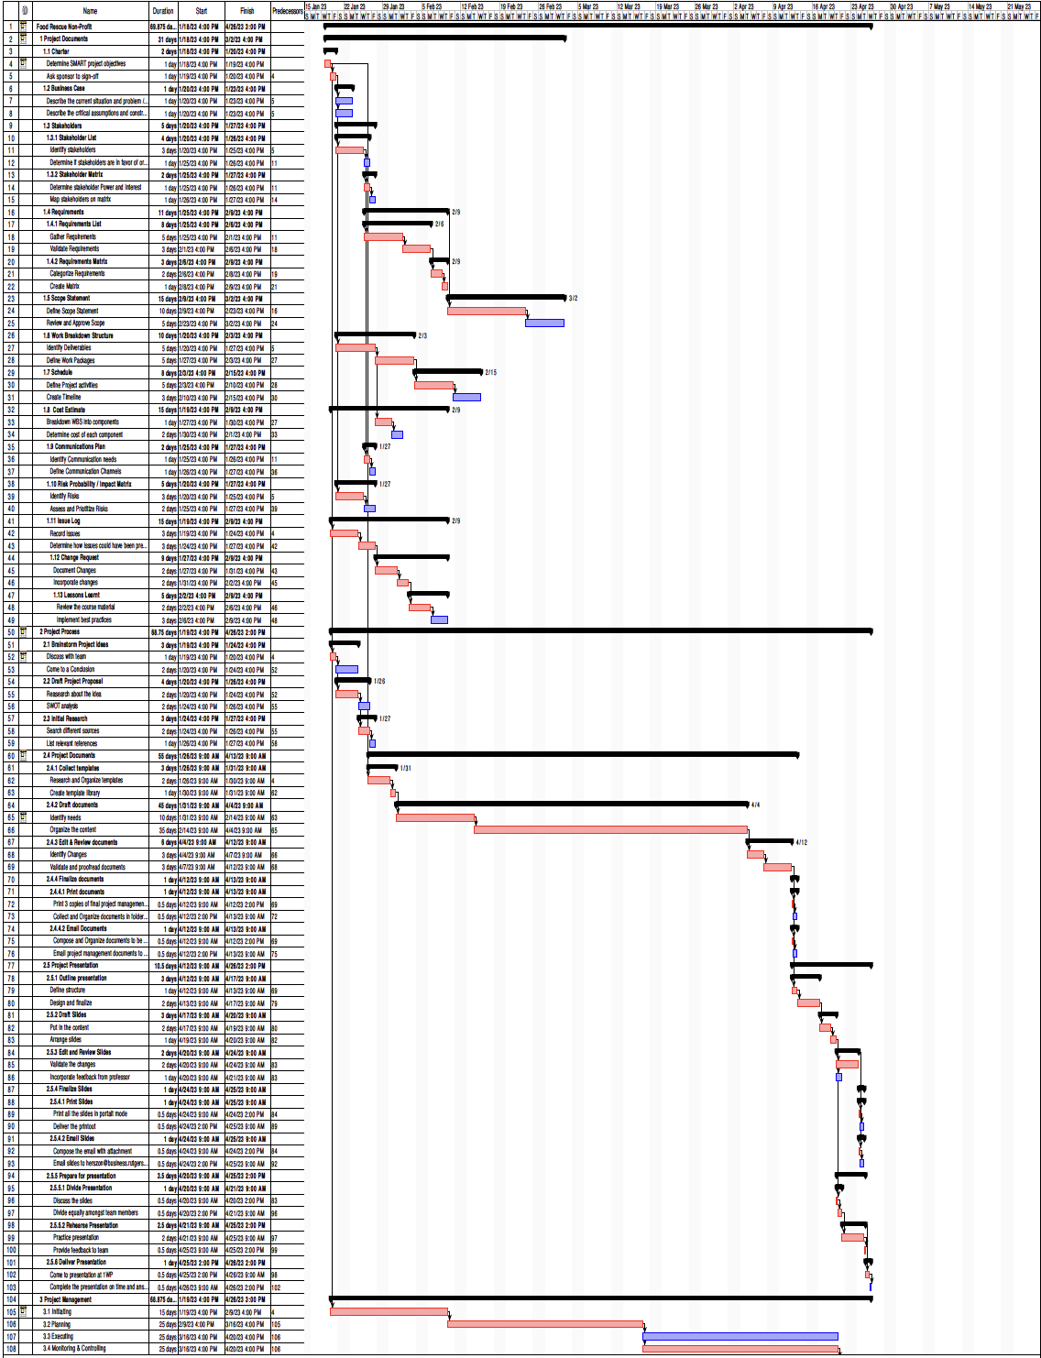
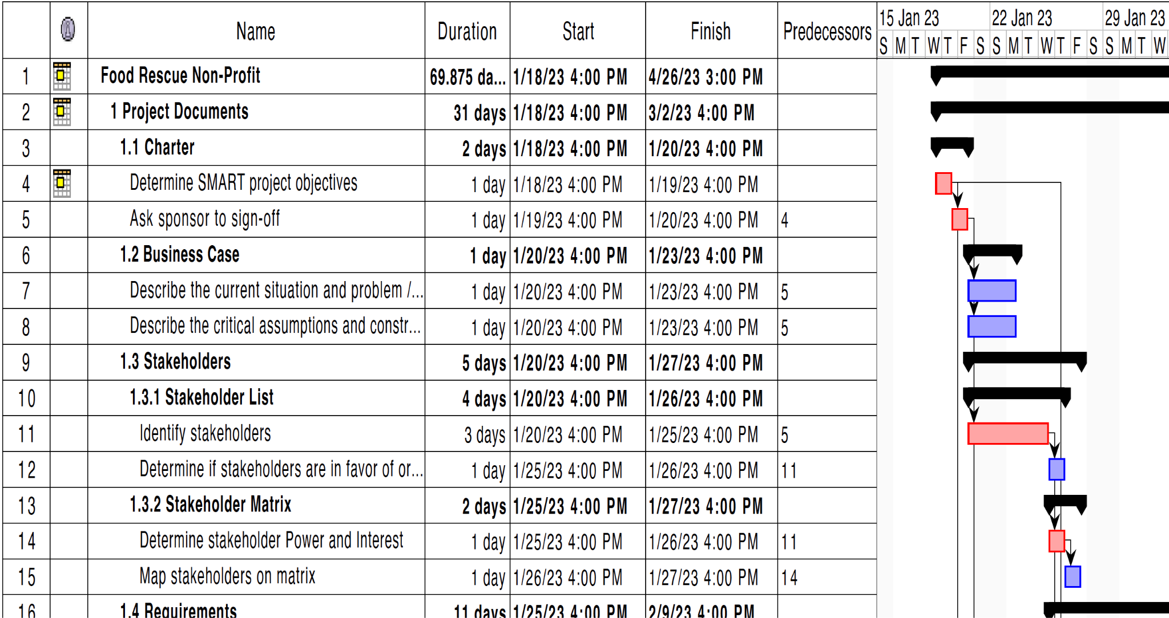
Schedule
Initiating
Planning
Executing
Monitoring & Controlling
Closing
Critical Path
Start & Finish
Work Package
Activities
Notes:
Namrata
Schedule: Listing of activities, deliverables, and milestones within a project, usually displayed as a Gantt chart (list project activities and their corresponding start and finish dates in a calendar format, relative to one another); usually includes a planned start and finish date, duration, and resources assigned to each activity. Based on the example provided in class, a project schedule will be constructed in Project Libre based on the WBS work packages. First, the WBS will be imported into the program, then each work package will be broken down into 2 activities. Activity durations will be estimated and activity predecessors will be defined; all activities will have a predecessor, except for the ones that depend on the project to start. The team will collaborate to create the skeleton of the schedule; remaining activities, durations and predecessors will be completed by two team members; all team members will review post-schedule completion and provide feedback. Updates will be made as necessary.

Slide 18
Cost Estimate
Initiating
Planning
Executing
Monitoring & Controlling
Closing
Brainstorm Project Ideas | 1 | 5 | $10 | $50 | $0 | $50
Draft Project Proposal | 1 | 5 | $10 | $50 | $0 | $50
Initial Research | 1 | 5 | $10 | $50 | $0 | $50
Collect Templates | 1 | 2 | $10 | $20 | $0 | $20
Draft Documents | 2 | 5 | $10 | $100 | $0 | $100
Edit & Review Documents | 4 | 5 | $10 | $200 | $0 | $200
Print Documents | 0.5 | 1 | $10 | $5 | $0 | $5
Email Documents | 0.5 | 1 | $10 | $5 | $0 | $5
Outline Presentation | 1 | 5 | $10 | $50 | $0 | $50
Draft Slides | 6 | 5 | $10 | $300 | $0 | $300
Edit & Review Slides | 3 | 5 | $10 | $150 | $0 | $150
Print Slides | 0.5 | 1 | $10 | $5 | $0 | $5
Email Slides | 0.5 | 1 | $10 | $5 | $0 | $5
Divide Presentation | 1 | 5 | $10 | $50 | $0 | $50
Rehearse Presentation | 3 | 5 | $10 | $150 | $0 | $150
Deliver Presentation | 1 | 5 | $10 | $50 | $0 | $50
Initiating | 5 | 1 | $10 | $50 | $0 | $50
Planning | 20 | 1 | $10 | $200 | $0 | $200
Executing | 15 | 1 | $10 | $150 | $0 | $150
Monitoring/Controlling | 15 | 1 | $10 | $150 | $0 | $150
Closing | 3 | 1 | $10 | $30 | $45 | $75
TOTAL |  |  |  | $2,985 | $45 | $3,030
Deliverable / WBS Item | Labor Cost |  |  |  | Non- Labor Cost | Total Cost
 | # Hours | # People | Cost / Hour | Total Labor Cost
Project Charter | 2 | 5 | $10 | $100 | $0 | $100
Business Case | 2 | 5 | $10 | $100 | $0 | $100
Stakeholder List | 1 | 5 | $10 | $50 | $0 | $50
Stakeholder Matrix | 0.5 | 1 | $10 | $5 | $0 | $5
Requirements List | 3 | 5 | $10 | $150 | $0 | $150
Requirements Matrix | 1.5 | 1 | $10 | $15 | $0 | $15
Scope Statement | 6 | 5 | $10 | $300 | $0 | $300
Work Breakdown Structure (WBS) | 2 | 1 | $10 | $20 | $0 | $20
Schedule | 3 | 5 | $10 | $150 | $0 | $150
Cost Estimate | 2 | 1 | $10 | $20 | $0 | $20
Communications Plan | 0.5 | 1 | $10 | $5 | $0 | $5
Risk Probability / Impact Matrix | 3 | 5 | $10 | $150 | $0 | $150
Issue Log | 0.5 | 5 | $10 | $25 | $0 | $25
Change Requests | 0.5 | 5 | $10 | $25 | $0 | $25
Lessons Learned | 1 | 5 | $10 | $50 | $0 | $50
Labor Cost per Hour
Notes:
Namrata
Cost Estimate: Document displaying an approximation or estimate of the costs of the resources needed to complete a project. Using the template provided in class, one team member will transpose the WBS deliverables into a table in Google Docs and estimate the approximate number of hours that will be needed to complete each work package. Based on the costs provided by the professor of $10/labor hour and any estimated non-labor costs, an estimate will be calculated. Team members will be consulted to review and to provide feedback as team members specifically working on specific deliverables will have the best understanding of the amount of time each deliverable may take. The estimate will be updated as necessary, especially if there are change requests

Slide 19
Communications Plan
Initiating
Planning
Executing
Monitoring & Controlling
Closing
Stakeholder | What | When | How | Who | Where
Client | Status of the project | 1x week | Verbal Status Report | PM | In Person or via Zoom
Client | Project Plan | End of Project (April 26, 2023) | Presentation | PM and all Team Members | In Person
Sponsor | Status of the project | 1x month | Status Report | PM | Email
Team Members | Individual progress on project | 1x week | Progress Report | All Team Members | In Person, via Zoom, or WhatsApp
Investor Panel | Project Plan | End of Project (April 26, 2023) | Presentation | PM and all Team Members | In Person
Competing Food Rescue Nonprofits | Nothing to be communicated
Food Insecure Citizens | Nothing to be communicated
Notes:
Namrata
Communications Plan: Document describing who will provide and receive data, when, and how the information will be presented. Using the template provided in class, one team member will brainstorm to determine what information should be communicated to each stakeholder, when the information should be communicated, how often the information should be communicated, by whom the information should be communicated, and where the information should be communicated. This information will be compiled in a table in Google Docs. The professor and all team members will be consulted to review and to provide feedback upon the initial plan. The plan will be updated as necessary.

Slide 20
Risk: Probability / Impact Matrix
Initiating
Planning
Executing
Monitoring & Controlling
Closing
5 of 20 Risks
Risk | Probability (1-5) | Impact (1-5) | Severity (P x I) | Action Plan | Contingency Plan
Project does not obtain funding from the investor panel (lose competition) | 4 | 5 | 20 | Mitigate. Ensure business case has persuasive reasoning for the project and all documents provide thorough and conclusive information. | Seek alternate funding options.
Overrun presentation time of 40 minutes | 2 | 4 | 8 | Mitigate. Rehearse with the team prior to the actual presentation. Have a timekeeper during the presentation. | Accept the consequences.
Team members not communicating well or clearly | 2 | 3 | 6 | Mitigate. Communicate early and often with team members through WhatsApp and in-person to ensure open communication and address any misunderstandings. | The PM can address (confront) issue(s) as they occur and discuss one-on-one to find a solution.
Failure to communicate effectively with client during project | 1 | 5 | 5 | Mitigate. Proactively seek client feedback throughout project planning; ensure understanding on both sides. | Clarify during in-person sessions. Make changes to communication style as required
Overrun budget; under-budgeting labor hours | 5 | 1 | 5 | Accept
Notes:
Namrata
Risk Probability / Impact Matrix: Probability/Impact grid based on risks that are likely to affect a project; technique to help decide which risks are most important. The team will meet via Zoom to brainstorm potential risks that can occur during the project. Once these risk events are identified and agreed upon, a collective qualitative risk analysis will be undertaken to determine the probability of each risk event occurring on a scale of 1-5, and the impact or consequence if the risk does occur on a scale of 1-5. Using the process and template provided in class, the team will collaborate on a table in Google Docs to compile a list of prioritized project risks (at least ten). Subsequently, the severity of each risk event will be calculated (probability x impact). Then, risk responses (accept, mitigate, eliminate, transfer) and an action plan will be determined for each risk taking into account the potential impact of the risk on meeting project objectives, as well as the severity of impact (probability x impact). Each risk will also have a contingency plan which is how we will respond to the risk if it becomes an issue/problem. All team members will review these risks after they have been compiled and provide feedback, if any. Risk events will be updated as necessary.

Slide 21
Executing and
Monitoring & Controlling
Notes:
SARANAYA

Slide 22
Issue Log
Initiating
Planning
Executing
Monitoring & Controlling
Closing
Issue | How could it have been prevented? | How to address this issue?
Team member got sick with COVID-19 | Wearing PPE, getting vaccinated, social distancing | Meet online via Zoom instead of in-person
Delays in completing the tasks as originally planned | Accurating planning– being flexible and setting up a realistic timeline with estimated duration and resources | Communicate as soon as possible about the delay and let team know when the new deadline is; reassign tasks if necessary
Lack of skills and knowledge | Determine if skills are lacking from various team members at the onset of project; distribute tasks appropriately; provide or seek training | Communicate with team; redistribute tasks as necessary; encourage knowledge sharing and team based approach on deliverables
Notes:
Document that monitors and tracks issues that need to be resolved for effective work to take place. Issues are matters under question or dispute that could impede project success. Using the template provided in class, the team will meet via Zoom at least 2 times to brainstorm issues that are occurring or that did occur and how they will be or have been solved. All team members will be involved in this deliverable.

Slide 23
Change Requests
Initiating
Planning
Executing
Monitoring & Controlling
Closing
Change: Add Business Case
Potential Impact
Implementation
Change Request #1
Submitted 3/1 by Client
Add a 1-2 page business case describing the reason(s) why we are starting this nonprofit. This should also be included in the presentation to the panel.
RISK: Low
SCOPE: Add 1 deliverable
SCHEDULE: 10 hours
COST: $100
Add deliverable to WBS, scope, and budget. Add the business case document and factor into the planning schedule (schedule resources as necessary).
Change: Present on Zoom
Potential Impact
Implementation
Change Request #2
Submitted 4/12 by Client
Presentation will be delivered via Zoom as well as in-person as at least one panel member will not be physically present.
RISK: Low
TECHNOLOGY: Presentation will be shared on Zoom (extra rehearsal time may be needed); Presenters will need to enunciate in order to be heard via Zoom
Rehearse presenting the presentation on Zoom prior to the final presentation.
One team member will share the presentation on Zoom prior to beginning the presentation.
Notes:
Change Requests: Document that describes any change requests made by any stakeholder either formally or informally, and how they impacted the final result of the project. Using the template provided in the book, a collaborative Google Doc will be created by one team member. This will be updated based on any change requests that occur during the course of the project, especially if the change impacts scope, time, or cost of the project. The change control process will be utilized if any change requests occur (identify the change, analyze impact, approval, implement, update plan(s)). All team members will be engaged to review the request after it has been made. Significant changes may require Client sign-off.

Slide 24
Closing
Notes:
SARANAYA

Slide 25
Lessons Learned
Initiating
Planning
Executing
Monitoring & Controlling
Closing
Process Group | Start Doing | Stop Doing | Continue Doing
Initiating | Set team expectations during week one (e.g. team meeting times) Take time to learn team strengths – design roles and responsibilities accordingly Set processes for communication, e.g. if scheduling issues occur |  | Plan ahead, don’t procrastinate Work on shared Google Drive for all documents Set agendas and do outs for every meeting
Planning | Divide responsibilities more evenly Break complex tasks into simpler ones Allocate specific tasks to individual team members. Don’t expect volunteers. | Having high expectations | Plan ahead, don’t procrastinate
Executing | Encourage team to ask questions if unclear Encourage team to solicit feedback from the professor | Take any criticism negatively | Create teams to work on specific sections Strict adherence to deadlines and scheduled meetings – less flexibility Group brainstorms and execution of work Send reminders for upcoming meetings
Monitoring & Controlling | Address issues early & often. Don't wait to see them work out on their own Practice patience with scheduling conflicts and completed work |  | Solicit questions from all team members individually to ensure comprehension Stay organized; review project status often and communicate that to team Give and receive feedback; try to help improve understanding Share updates often + encourage sharing Attempt new forms of communication to find what works best
Closing |  |  | Involve team in lessons learned
Notes:
Lessons Learned: Document describing the lessons learned during the project. Using the process provided in class, the team will meet in-person to brainstorm things that they should “start doing, stop doing, and continue doing.” This brainstorm will involve post-it notes that are written upon and then adhered to a planning page hanging upon the wall. After the initial brainstorm, the team will remove any redundant ideas, and then organize the remaining ideas by process group (initiating, planning, executing, monitoring & controlling, closing) and action (“start doing, stop doing, and continue doing”) . One team member will use the template provided in class to create a collaborative Google Doc and transfer the information captured during the in-class exercise. This process may be undertaken again prior to document and presentation finalization.

Slide 26
Thank you!
Any questions?
Notes:
SARANAYA

